Slide 1

ME 200 Thermodynamics
Lecture 06 – Properties

Slide 2
Methods for Determining States
Tables
Figures
Equation of States (EOS)
Computer
Notes:
We will not use computer, since the computer gets information from the tables, figures and equations of states

Slide 3
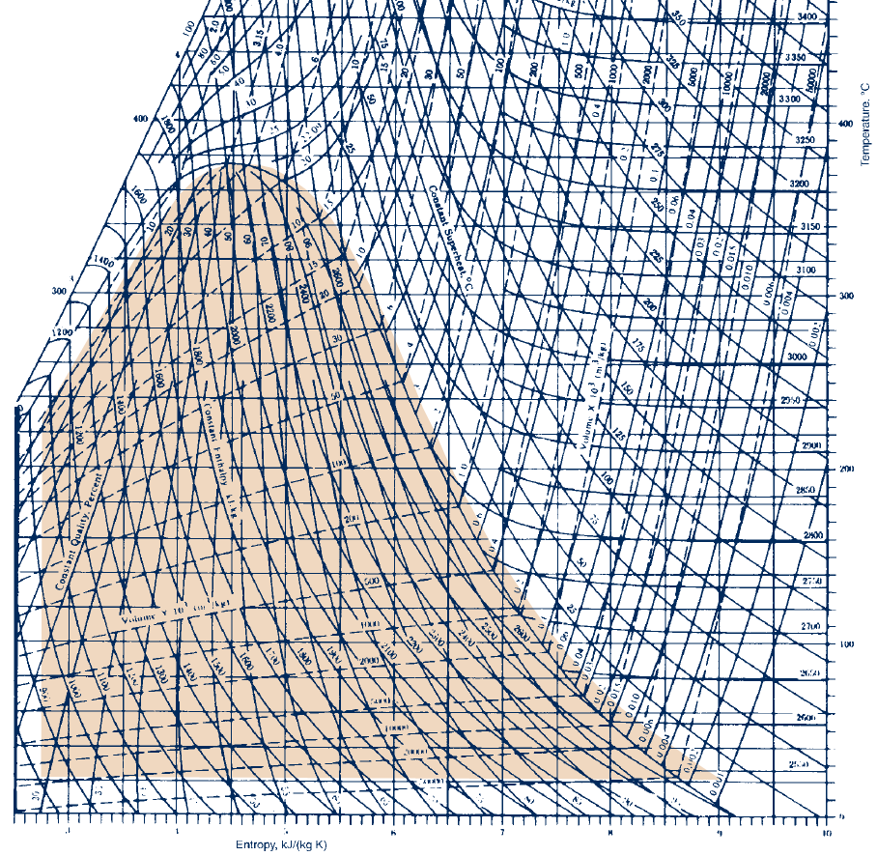
Figures
Figures
Temperature–entropy diagram for water (SI units).

Slide 4
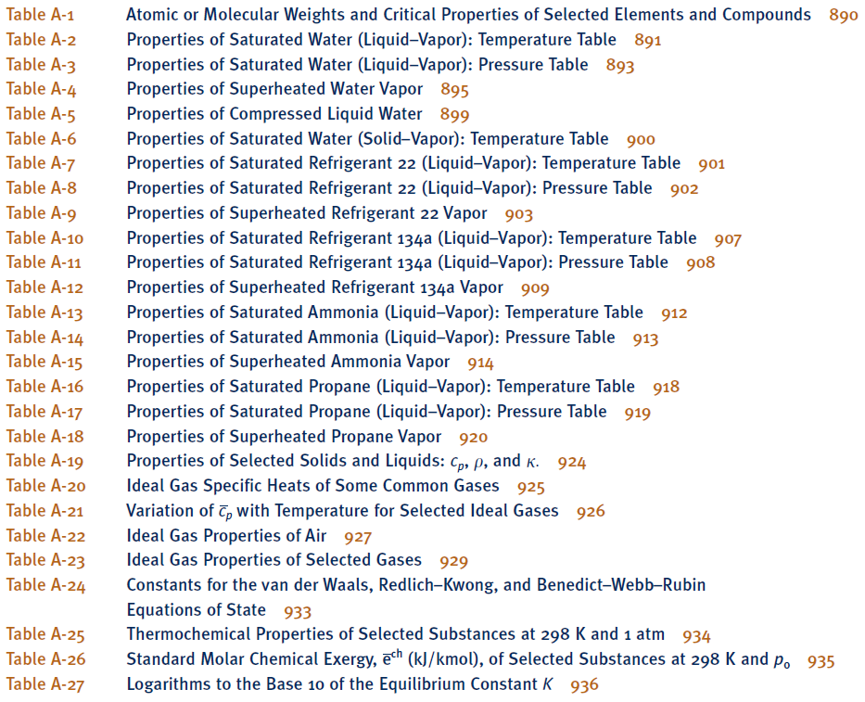
Tables

Slide 5
Tables
p
A-5
A-2
A-4
A-3
v
A-6

Slide 6
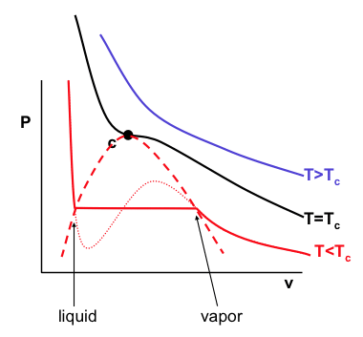
Tables
P_{sat}
1 x 10⁻³
Connection Between Property Tables and
the L-V Phase Diagram
Notes:
Does not apply for an incompressible fluid. For example, given T & v => u is known, but h is not.

Slide 7
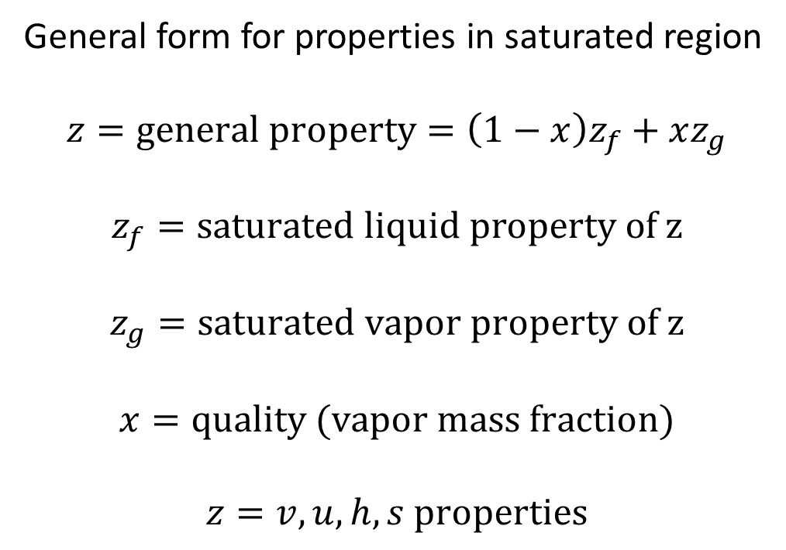
Tables
First determine the phase (liquid, saturated or vapor)
Use the proper table, interpolation is often method needed to find the wanted values for the state
General form for properties in saturated region
$$z=general property=\left(1−x\right)z_{f}+xz_{g}$$
$$z_{f}=saturated liquid property of z$$
$$z_{g}=saturated vapor property of z$$
$$x=quality (vapor mass fraction)$$
$$z=v, u, h, s properties$$

Slide 8
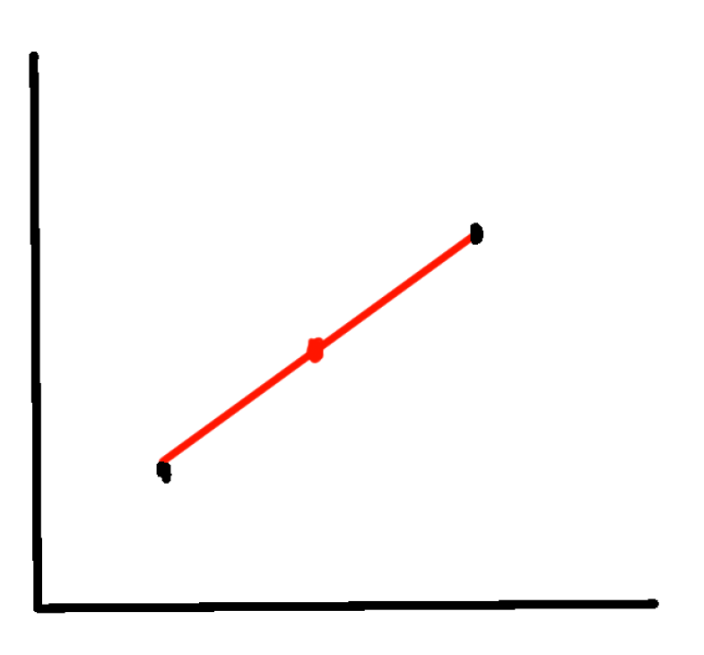
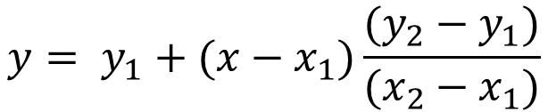
Interpolation
$$y= y_{1}+(x−x_{1})\frac{(y_{2}−y_{1})}{(x_{2}−x_{1})}$$
y = linear interpolation value
x = independent variable
x₁,y₁ = values of the function at one point
x₂,y₃ = values of the function at another point

Slide 9
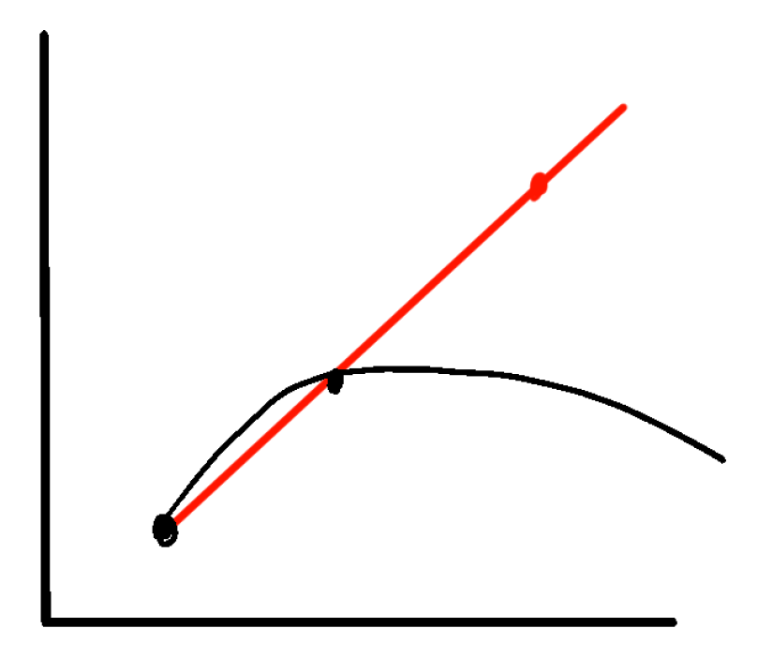
Extrapolation?
There are two types of people in this world:
1. Those who can extrapolate incomplete data.

Slide 10
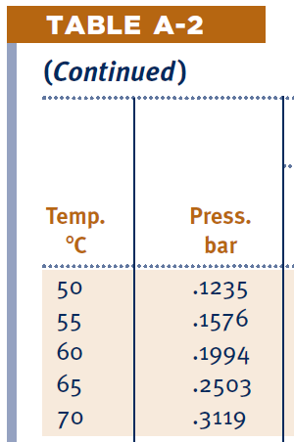
To Determine the Phase
Consider the case when T & p are given:
Lookup T
If given p > p_{sat}
If given p < p_{sat}

Slide 11
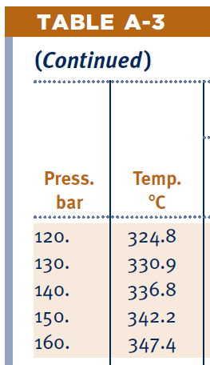
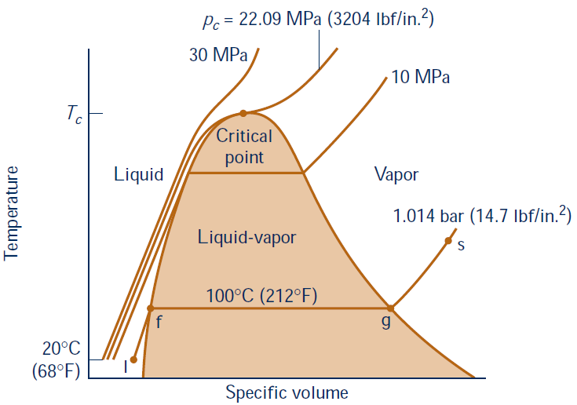
To Determine the Phase
Consider the case when T & p are given:
Lookup p
If given T < T_{sat}
If given T > T_{sat}

Slide 12
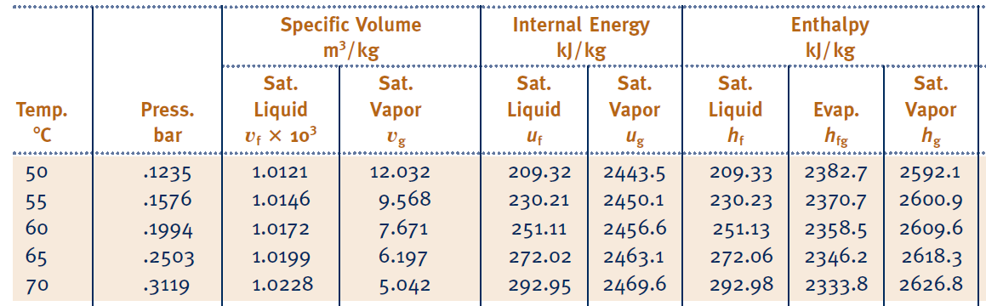
To Determine the Phase
Consider the case when either T or p plus another property are given:
Lookup T or p at saturation Table A-2 or A-3
Compare another property with it

Slide 13
Get your textbook!
What is the value of the specific volume of a saturated liquid, v_{f}, at 30ºC?
32.894 m³/kg
1.0043 m³/kg
1.0043 × 10⁻³ m³/kg
1.0043 × 10³ m³/kg
0.04246 m³/kg

Slide 14
Get your textbook!
What is the saturation pressure of water at 80ºC?
0.4739 bar
295.1 bar
0.06 bar
25 bar
0.35 bar

Slide 15
Example
Water is at 5 MPa and 30 ºC. Find specific volume?

